Slide 1
Humanities Data: Text Analysis With Voyant
Sara Duke
Senior Digital Methods Specialist, IDAH; MLS/MIS

Slide 2
Using this guide
This slide deck is student-facing, intended for classroom use. These activities can be used either as a one-time class introduction to digital text analysis or for a semester-long project .
It consists of 3 individual activities (Slides #3-7, 8-14, 15-19). If you only want to practice in Voyant, skip to slide 15.
Click here to access the full written lesson plan.
If you have additional questions, or want to take your text analysis pedagogy or research further, please reach out to us at idah@indiana.edu and we would be happy to schedule a consultation.

Slide 3
Part 1: understanding humanities data and text analysis

Slide 4
What is humanities data?
Text analysis relies on a data set, but humanists often think about evidence rather than data sets. What’s the difference?
Humanities data is…
Multi-faceted: books, paintings, annotations, marginalia, brushstrokes, bibliographies
Can be structured (i.e. bibliographies), unstructured (i.e. annotations), or follow idiosyncratic structures
Highly interpretative: can have implications for sharing and reuse
Data creation process is iterative and layered

Slide 5
Text analysis (data mining)
Select or collect texts in order to explore a hypothesis
01
Look for patterns within an individual text and/or within sets of texts
02
Discover relationships between parts of texts, whole texts, or sets of texts
03
Interpret the significance of these patterns, relationships, and texts
04
Develop arguments for the larger significance of these interpretations
05

Slide 6
Why is data mining important?
Generate new insight of the subject or data set
Understand the relationships among textual elements
Open up new research questions either for yourself or others
Public data encourages further analysis
Gather feedback to understand different perspectives

Slide 7
Activity 1: humanities data
Split up into groups or partners and discuss the following:
Think about the text for this class. What would you like to explore further? Do you think digital text analysis could help you do that?
Can you think of any existing digital text analysis projects that you could model your research questions after?
How do you think the visualizations in Voyant could help or hinder your argument?

Slide 8
Part 2: preparing the data set

Slide 9
3-step process to data preparation
Data Gathering
Downloading/Web Scraping
File Naming Conventions
Transcription/OCR
Data Cleaning
Tokenization
Removing Extra-Textual Information
Fixing OCR Errors
Data Segmentation/Chunking
Structure
Book => Chapters
Temporal
Newspaper => Articles
Thematic
Letters => Certain Recipients
DON’T FORGET: ALWAYS KEEP AN ORIGINAL VERSION OF YOUR DATA SET!

Slide 10
Example data sets
Example research questions
A Single Text or Collection of Texts (Novels or Plays)
Shakespeare’s Plays
Jane Austen’s Novels
Journal Entries
Martha Ballard’s Diary
Correspondence
Alexander Hamilton’s Letters
Newspaper Articles from a Single Journal or Certain Subjects
New York Times
What do the visualizations in Voyant reveal about the data set?
What major words, topics, or themes can I see using Voyant?
How is Voyant used as an effective close reading tool?

Slide 11
Data gathering
Downloading/Web Scraping
How are you getting your data? Is it from a webpage, or a collection of files?
Save it somewhere you know you can find it easily
File Naming Conventions
How do you search for content? What is the best organization system for your own purposes?
Standardizing file names helps keep your data organized and lets you find
Also consider sustainable file formats, folder hierarchies
Transcription/OCR
How are you getting your text? Is it pre-made, or do you have to acquire it?
OCR (optical character recognition): electronic or mechanical conversion of images of typed, handwritten or printed text into machine-encoded text

Slide 12
Data cleaning
Tokenization and Concatenation
Are there text elements that need to be edited for clarity and consistency?
Standardize names, combine words into phrases, etc.
Removing Extra-Textual Information
Are there things in your text that you don’t need?
Page numbers, chapter titles, copyright information, etc.
Fixing OCR Errors
How accurate was your text acquisition?
Spelling errors, incorrect character choices, etc.

Slide 13
Data segmentation
Structure
How is your text structured originally? Should you keep it the same? Should you make different decisions based on your research questions?
Book => Chapters
Series => Individual Novels
Temporal
Are there time implications for your text? Could your analysis be affected by comparing different timeframes?
Newspaper => Articles
Lifespan => Key Life Events
Thematic
Are there different themes you are looking for in your data set? Do you see traits that could be considered their own subsets?
Letters => Certain Recipients
Musical Lyrics => Acts

Slide 14
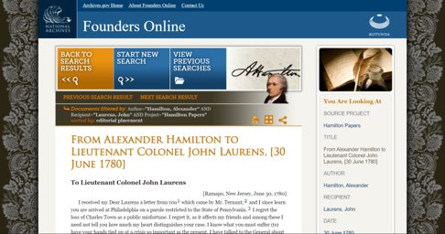
Activity 2: Data cleaning
About our corpus
Steps for activity 2
Source of corpus:
https://founders.archives.gov/​
Hamilton’s outgoing correspondence​
1774-1804​
3,508 letters total
Go to http://tiny.cc/texts_voyant​
Click on Exercise _1.md

Slide 15
Part 3: using voyant

Slide 16
Voyant: an introduction
Scholarly project designed to facilitate reading and interpretive practices for digital humanities students, scholars, and the general public
Used for analyzing and visualizing digital texts
User-friendly: online, open-source, work with multiple file formats and multiple languages
Tool for exploration and assistance with interpretive practices

Slide 17
Voyant vocabulary
Corpus: a collection of written texts
Stop Words: the most common words in a given language which are filtered out before natural language processing
Frequency: how often a word or phrase appears in a corpus
Distinctive words: words that are unique to a certain document within the corpus

Slide 18
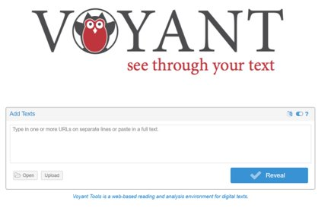
Activity 3: practice with voyant
Go to https://voyant-tools.org/​
Play with the sample corpora: either Shakespeare’s Plays or Jane Austen’s Novels
What is your first impression of the results?
Is Voyant showing you details you hadn’t considered?
Which tools are most effective for use with your research question?

Slide 19
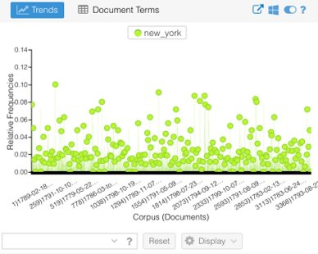
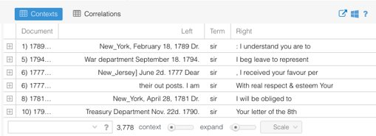
Additional resources
10-Minute Voyant tutorial:
https://www.youtube.com/watch?v=DlLAiPWbsIA
Voyant modules (20+) with brief descriptions:
https://digihum.mcgill.ca/voyant/tools/​
Step-by-Step Voyant Tutorial:
http://docs.voyant-tools.org/category/workshops/​
Export Graphs/Charts and Data from Voyant ​

