Slide 1
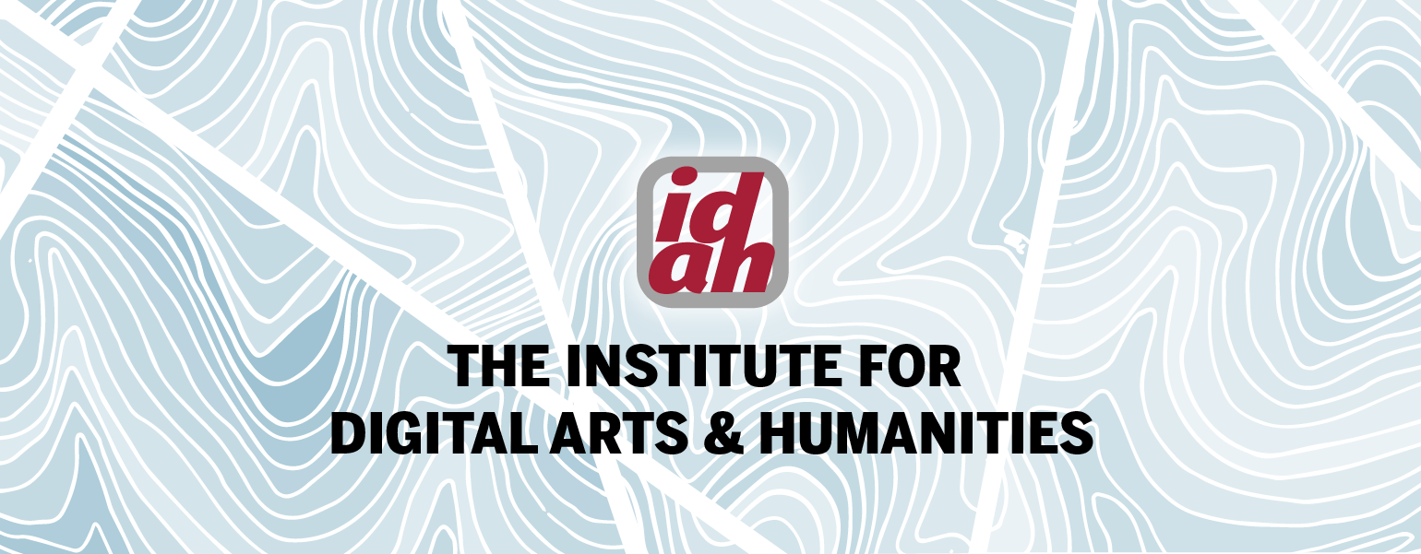
Digital Mapping Using Clio
Vanessa Elias Digital Methods Specialist, IDAH; Ph.D. Candidate, Spanish & Portuguese

Slide 2
Note to instructors
The following PowerPoint lesson plan is a student-centered lesson which introduces students to the basics of documenting important physical landmarks and other real-world places, and an introduction to how to use the website Clio.
For more information about the learning objectives and recommended steps for using Clio please refer to the Instructor Guide.
If you have any questions, please email us at idah@indiana.edu

Slide 3
Activity 1 : Learning to use Clio
Estimated time – 20 minutes

Slide 4
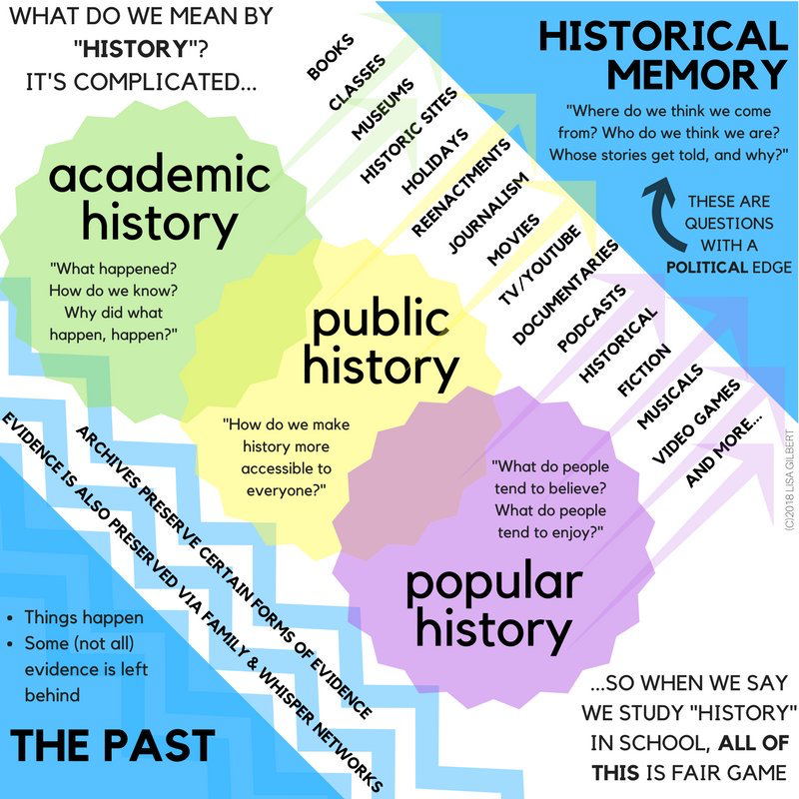
What is history?
How can we define history?
What is considered history?
Is it possible to have different types of histories?
How can we document/preserve history?
How can we use technology to document history?
Image courtesy of Lisa Gilbert, #twitterstorians and the American Historical Association
https://www.historians.org/publications-and-directories/perspectives-on-history/october-2018/to-chart-a-course-helping-middle-schoolers-broaden-their-vision-of-history
Notes:
In the last question, emphasize the use of digital methods for documenting history. By doing so, you will transition into the introduction of Clio.

Slide 5
Introduction – Clio
What is it?
It is a website that allows the public to view historical and cultural sites throughout the country.
Entries are crowdsourced and include short summaries and useful information about the landmarks.
Functions, like walking tours/ heritage trials, allow the entry creators to tell the public a story by guiding them through different locations.
Why is it important?
It allows you to explore the rich history and culture that is around you. Often, we are unaware of important landmarks or art that we pass by everyday. Clio allows us to find these hidden gems and allows us to share this information with others.
It also helps you develop critical thinking and research skills to help you succeed in our current digital world.

Slide 6
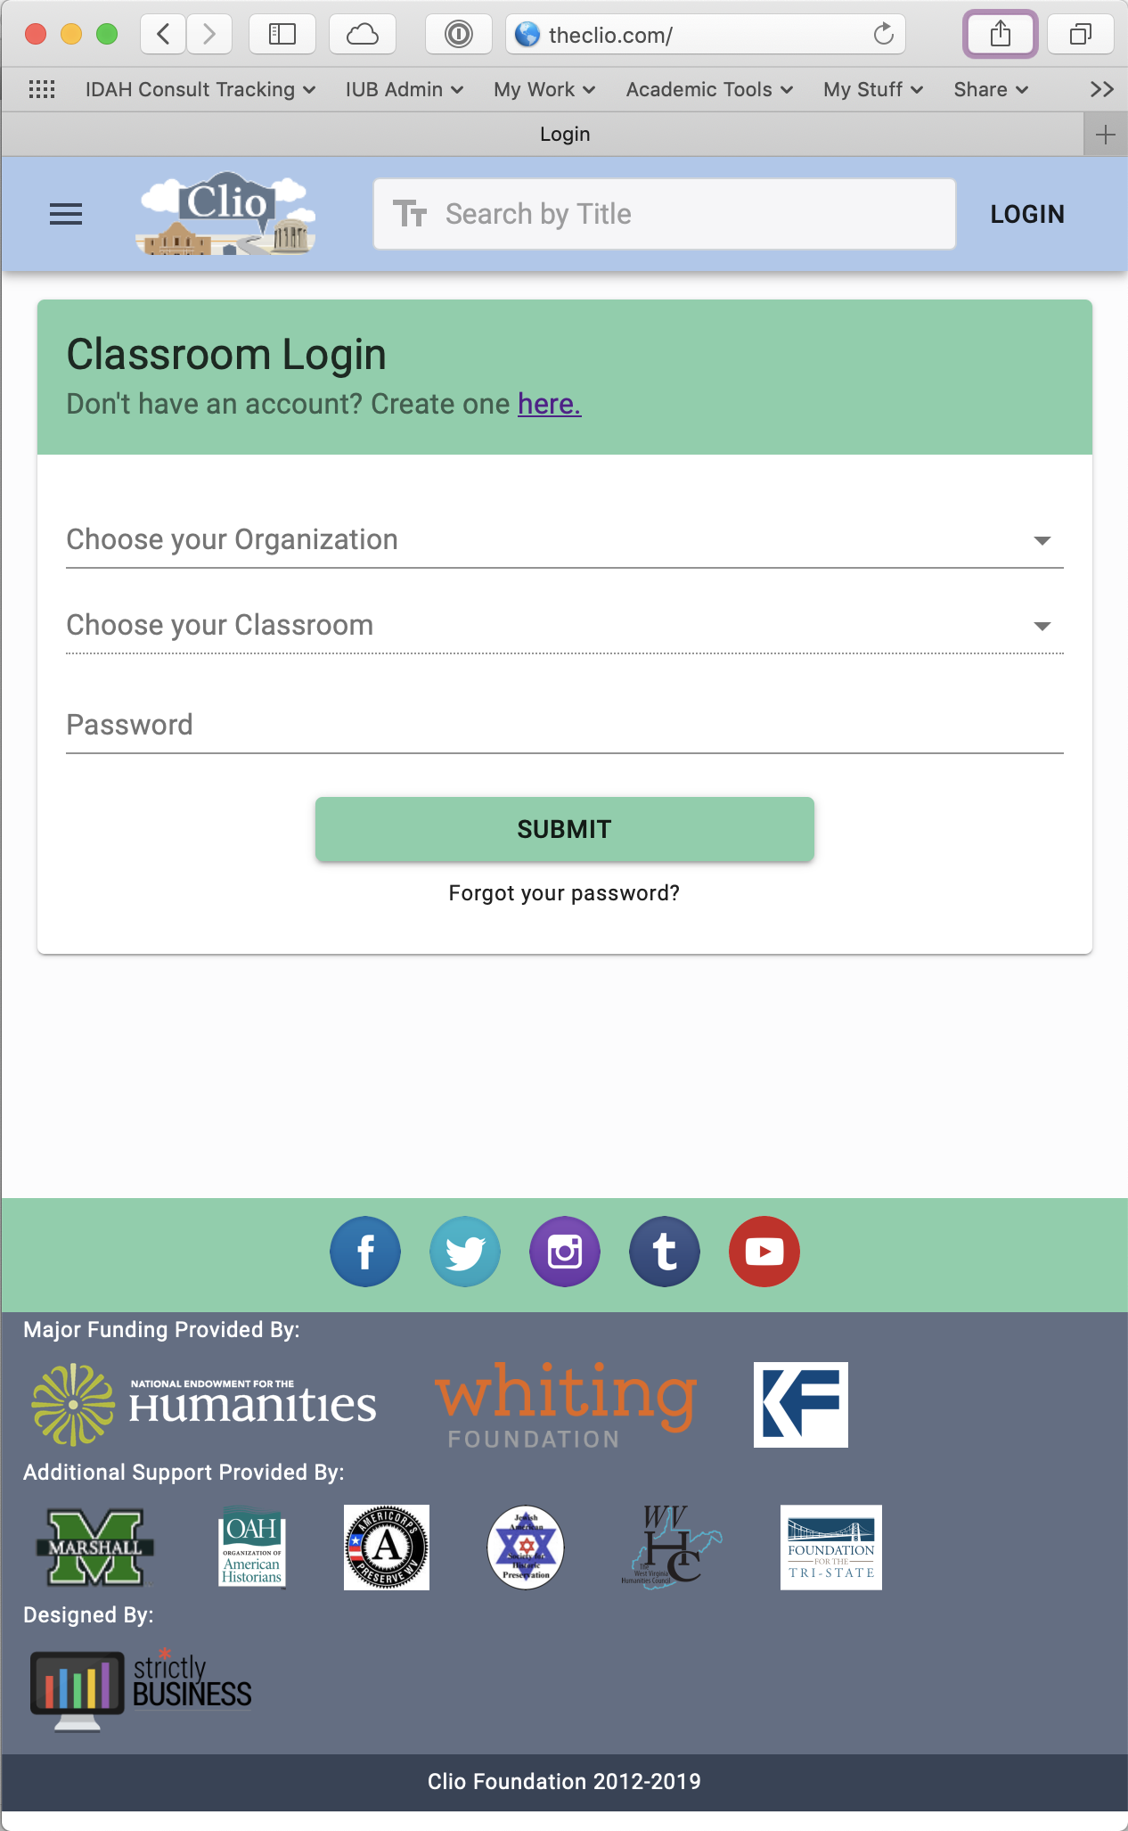
How do we turn “stories” into “histories”?
And how do digital methods help us do that?
In groups of 2:
Introduce yourself and choose a “guide” and a “scribe”
On the scribe’s phone, log in to TheClio.com
Login -> Classroom Login
Password: [insert classroom password]
Confirm you’re in and can see something like this
On the guide’s phone: take a photo of the next slide and use it for reference.

Slide 7
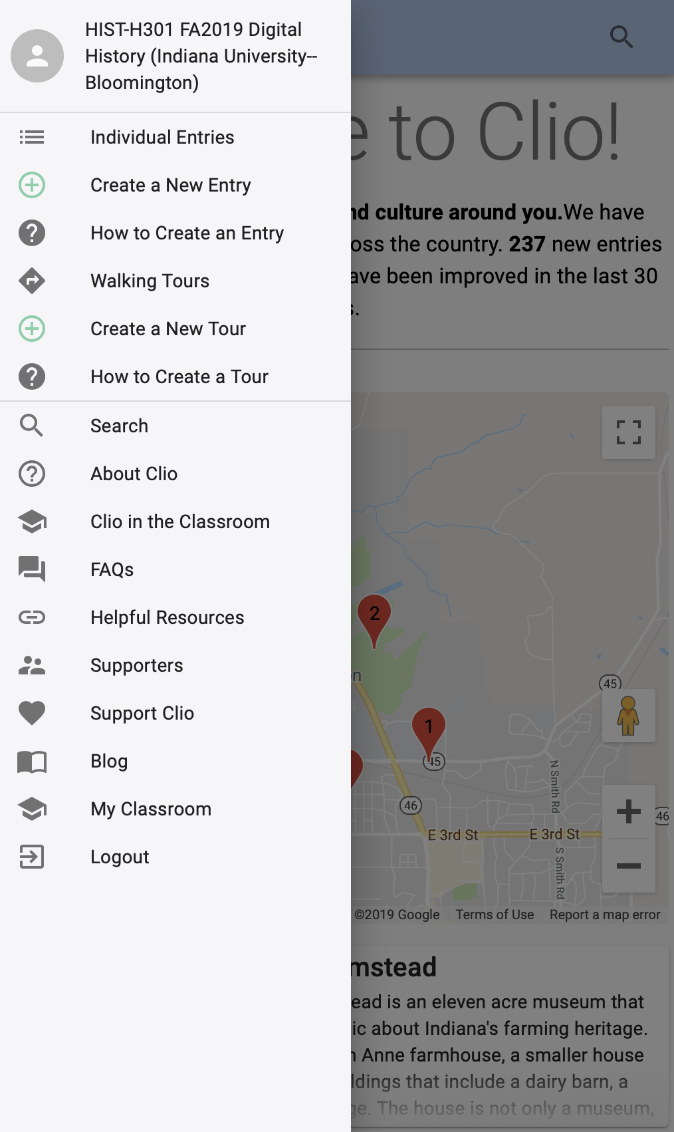
A 15-minute digital history
When instructed, set a timer for 15 minutes and go explore.
Find something nearby that no other team has chosen that *you* think might have historical significance. (A plaque? A construction zone? A tree?)
On the scribe’s phone use TheClio’s “+” to “Create a New Entry”
Menus change as screen sizes change
Follow the series of screen prompts to place a pin for your historical entry, confirm that there are no duplicates, write a description, and upload a photo.
The “Introduction” and ”Backstory/Context” fields require minimum word counts and citations. Do not try to meet those word counts. Instead, describe the historical significance of your entry as best as you can in the Backstory field. Copy that into the introduction and make a few extra copies of it at the end of the Backstory field until you hit the minimum. Ignore the other text fields for now.
Enter your team members’ names in the “Signature” field
“Save for later” and come back to the classroom. (**The button will look grey, click it anyways)

Slide 8
How did it go? Was it difficult? User-friendly?
Image courtesy of Lisa Gilbert, #twitterstorians and the American Historical Association
https://www.historians.org/publications-and-directories/perspectives-on-history/october-2018/to-chart-a-course-helping-middle-schoolers-broaden-their-vision-of-history
Notes:
In the last question, emphasize the use of digital methods for documenting history. By doing so, you will transition into the introduction of Clio.

Slide 9
What questions do you have about using Clio?

Slide 10
Activity 2: Critiquing existing entries as a learning tool
Estimated time – 20 minutes

Slide 11
Activity – Part 1
Note to instructors : We recommend that you give your students a grading rubric/ guidelines for expectations and review it with them before starting this activity. The Clio website has a sample rubric.
** Please delete***
Find a partner
Go to http://theclio.com/
Search: Dunn Cemetery
Look over the entry and keeping the rubric in mind:
What did they do well? What aspects did you enjoy?
Where is there room for improvement?
Consider the descriptions, images, and sources

Slide 12
Activity – Part 2
In groups, let’s examine a walking tour
Search: Historical Downtown Bloomington Walking Tour
Look over several entries (~3) and the initial description of the tour, keep the rubric in mind:
What did they do well? What aspects did you enjoy?
Where is there room for improvement?
Consider the descriptions, images, and sources
As you think about your own projects/assignment, keep in mind the aspects that you thought were successful and ones that could be improved and make sure you hit all those points.

Slide 13
Minimum requirements for entry in Clio
Title
Introduction → 4 – 8 sentences, minimally 50 words.
Backstory and context → 3-6 paragraphs, minimally 100 words
Must include sources
Can include images and links to videos
Signature → include your name/group member names
Recommendation: write out all the information in a word document and when it is ready, copy and paste into the website.

